Slide 1
Alumni Europae ASBL
16 November 2021 – Financial Survey Results

Slide 2
General statistics
5300 members
67 respondents (53 EN + 14 FR)
= 1,25% of all members

Slide 3
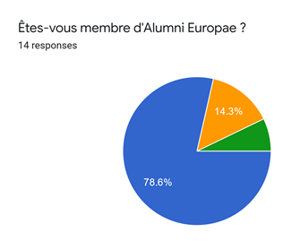
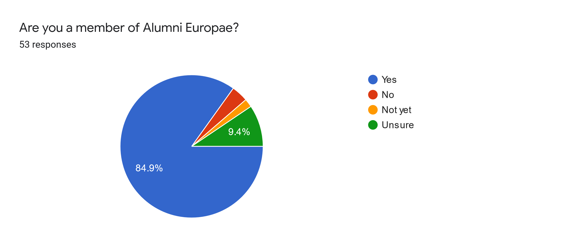
Class of Respondents

Slide 4
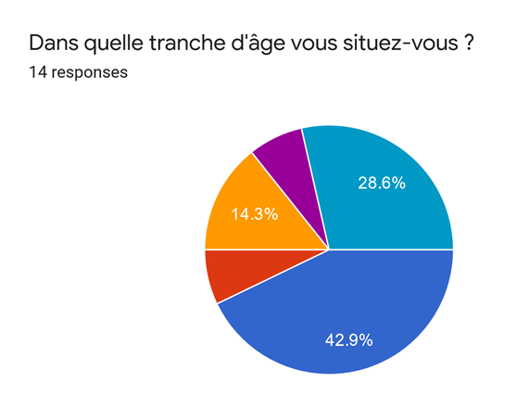
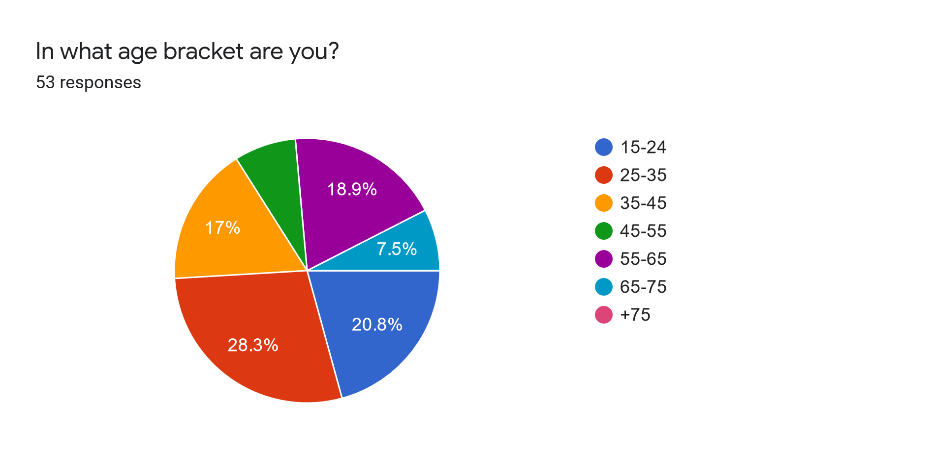
Age Bracket respondents

Slide 5
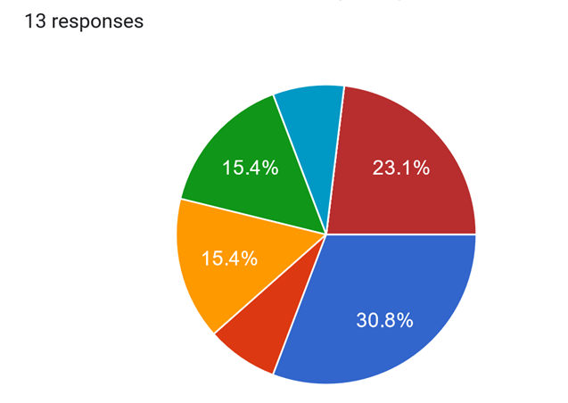
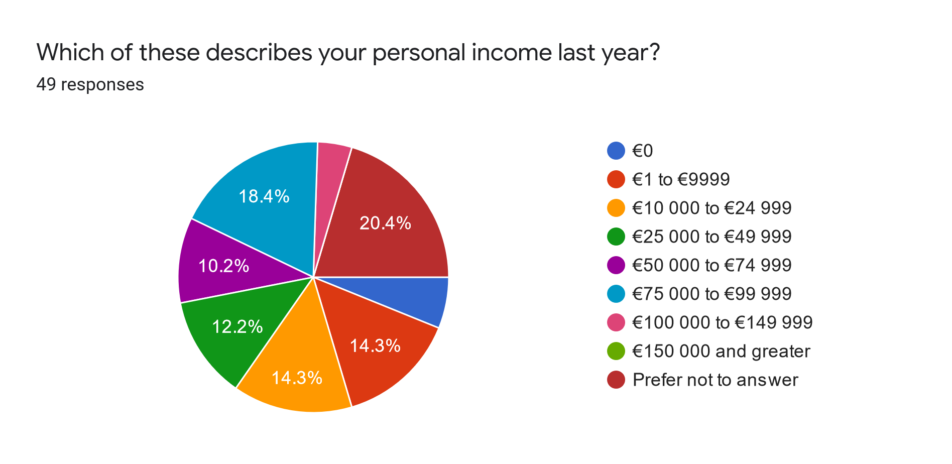
Personal Income Respondents

Slide 6
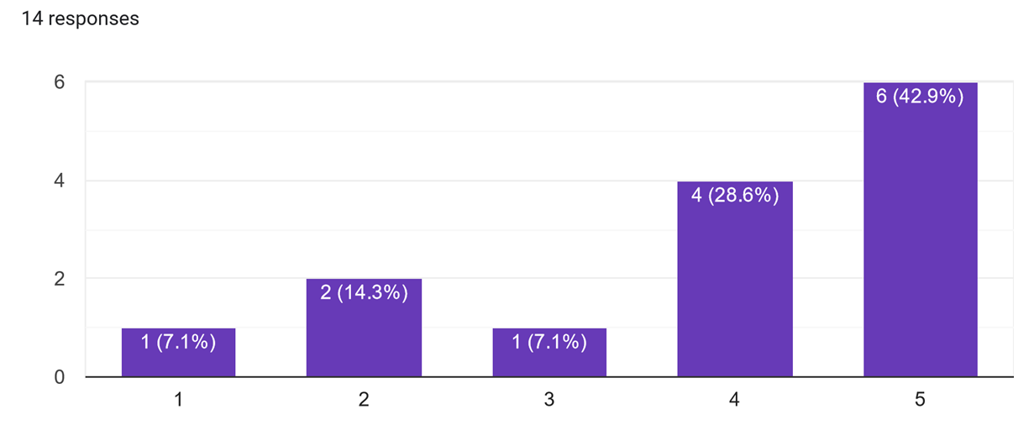
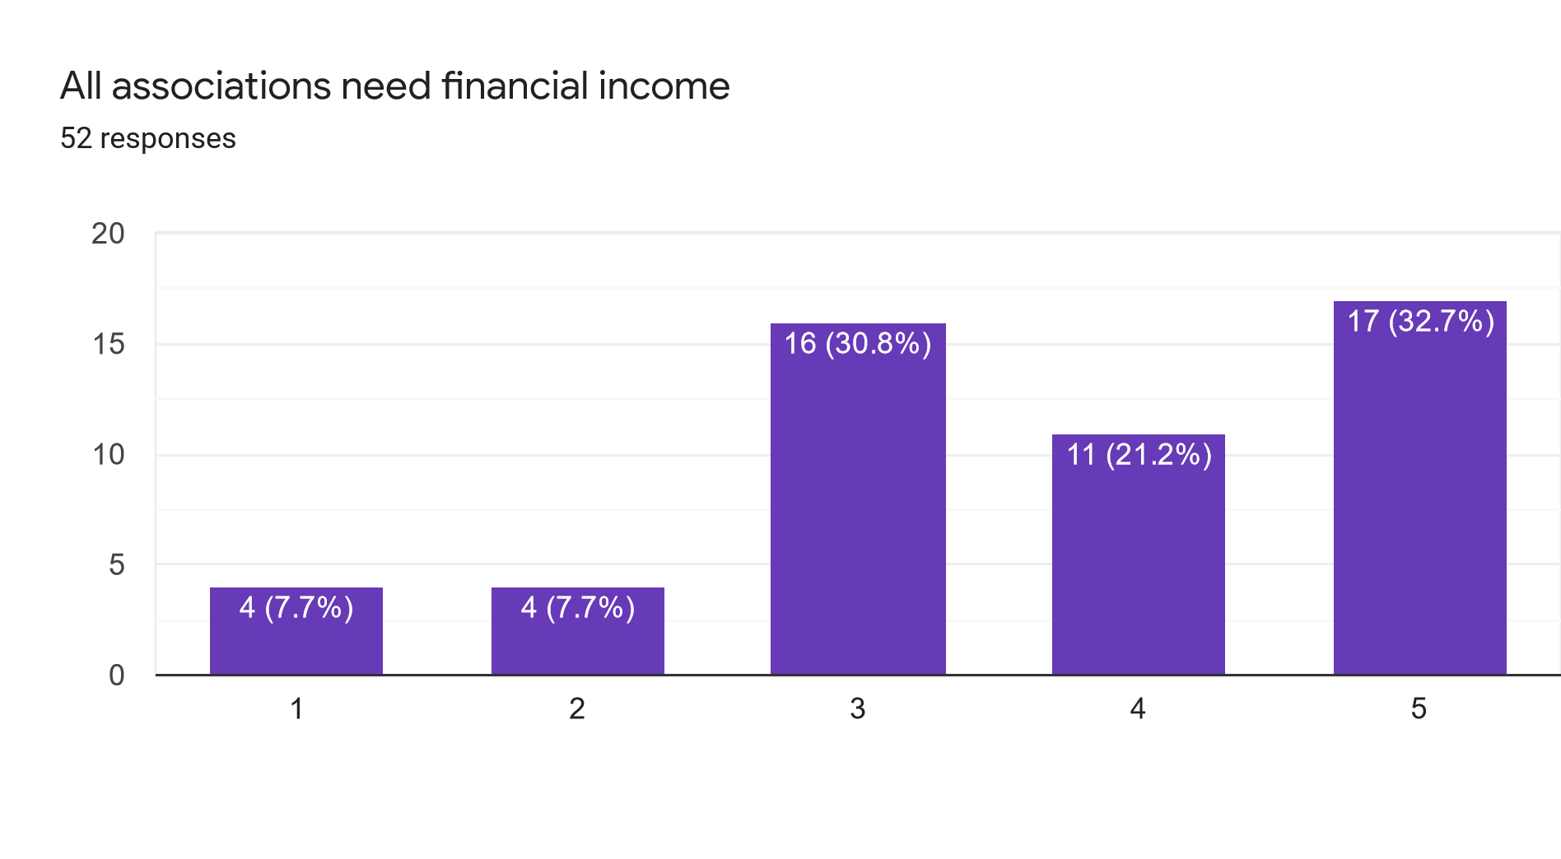
Do you agree?

Slide 7
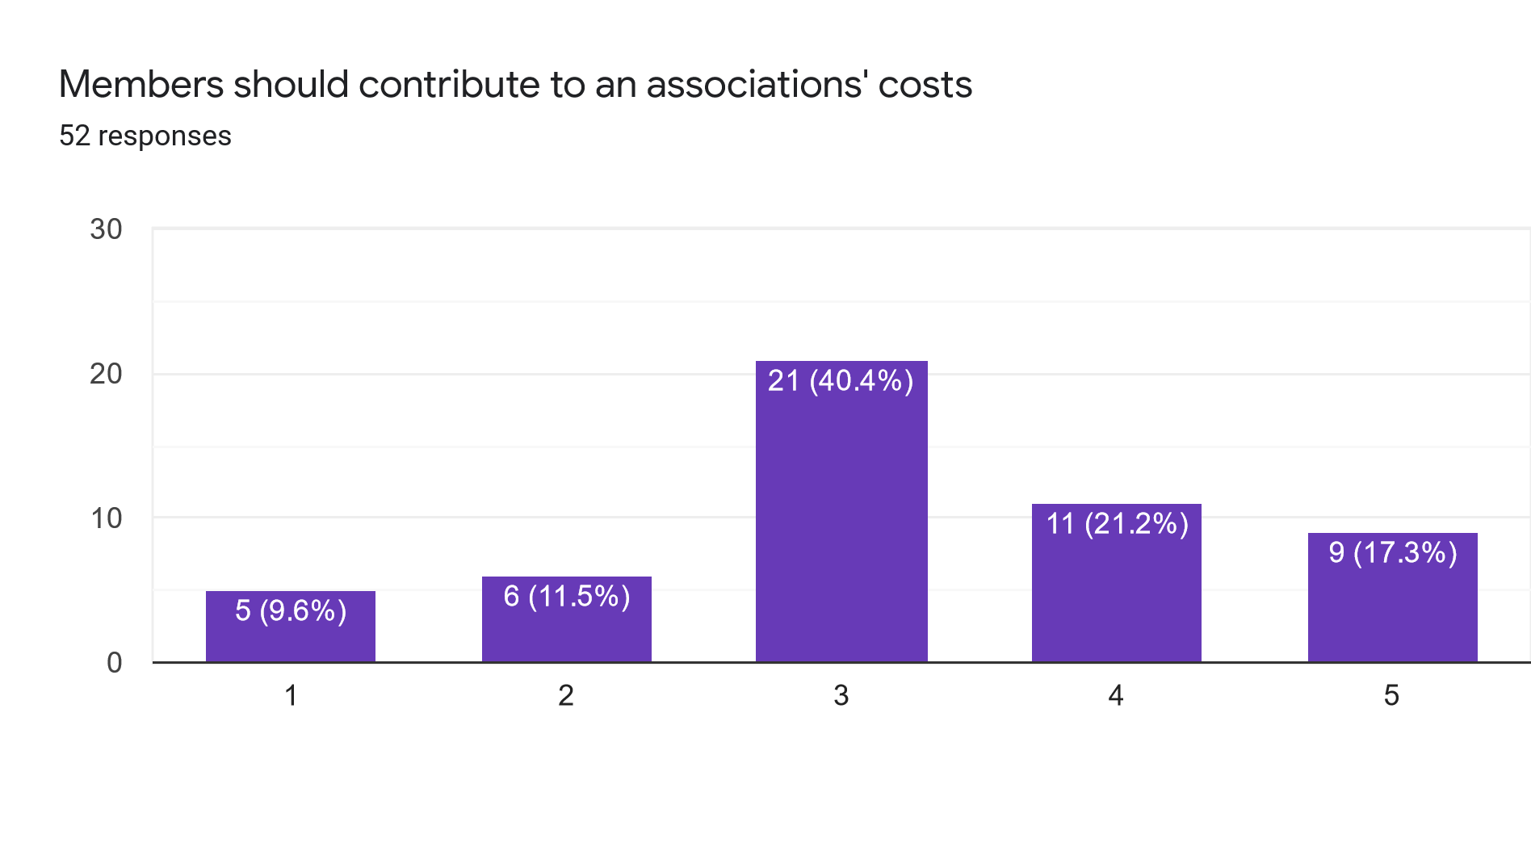
Contribution by members

Slide 8
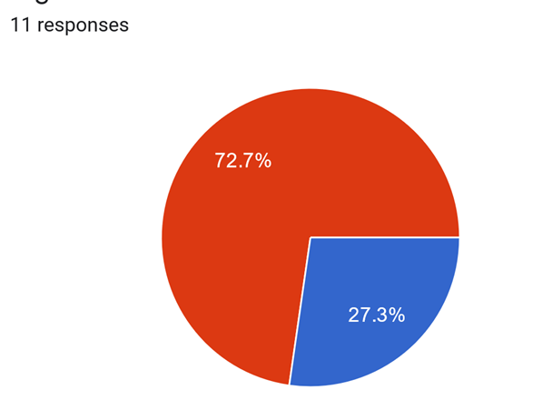
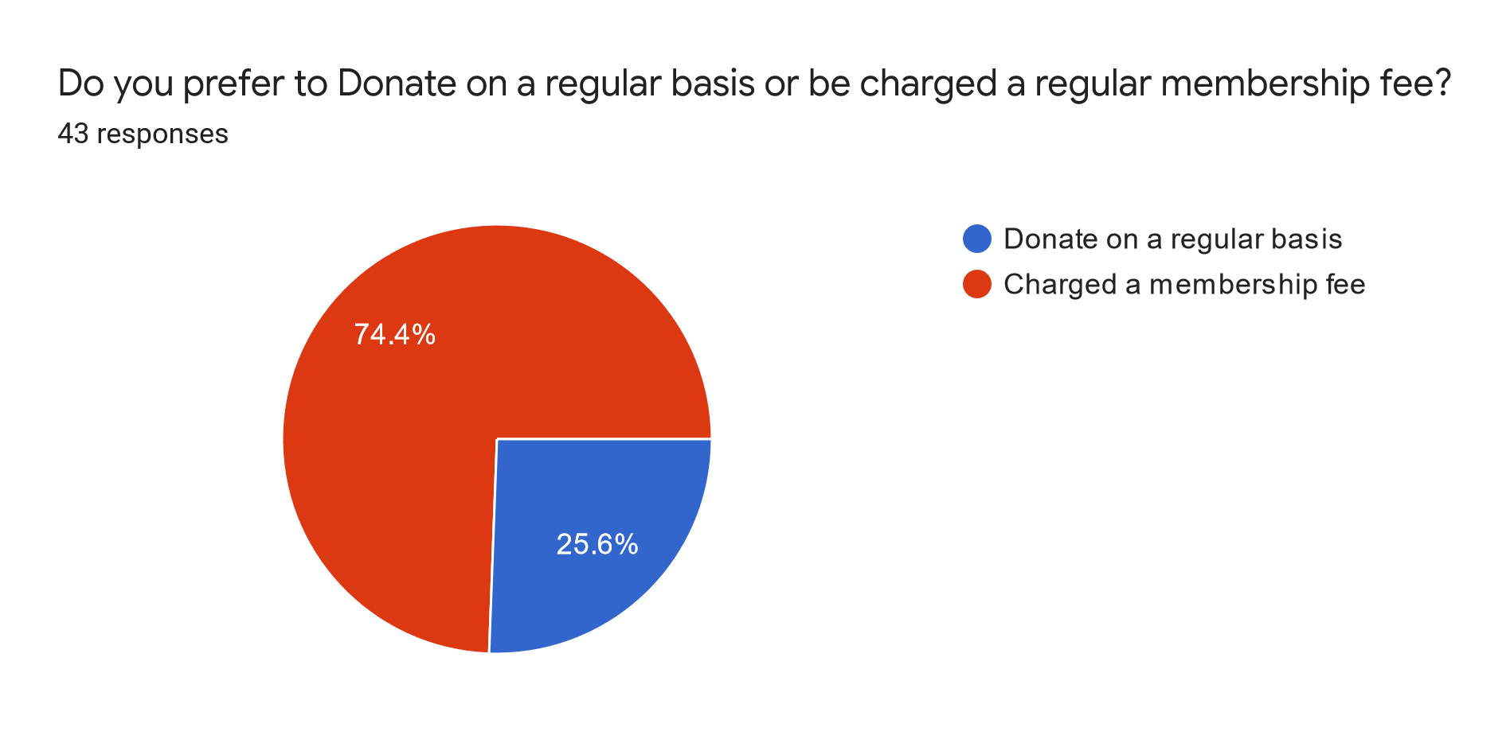
Membership fee vs Donation

Slide 9
Fee amount
0 min
100 max
22 average
10 median

Slide 10
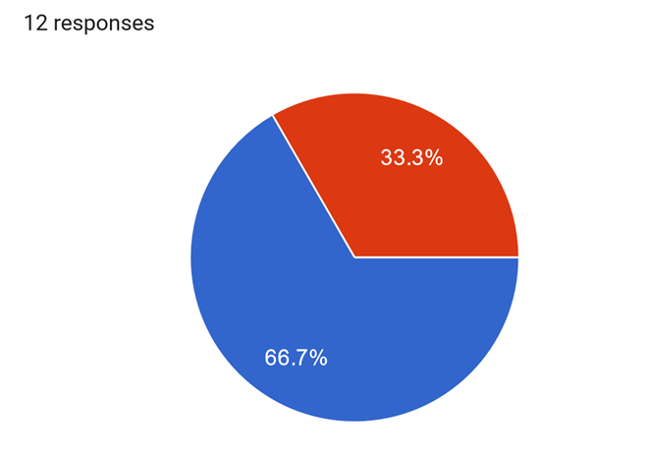
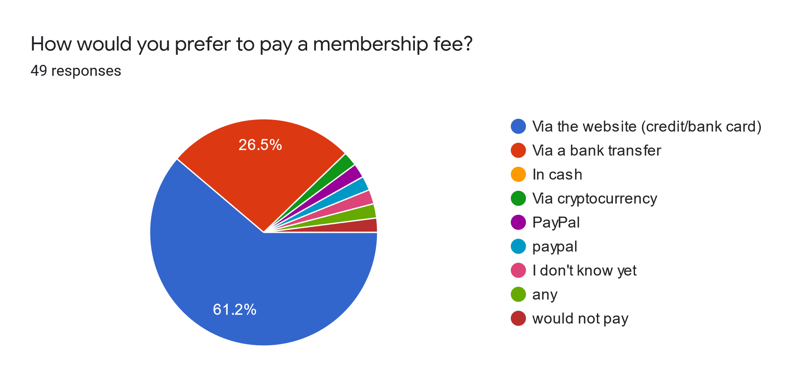
Payment process

Slide 11
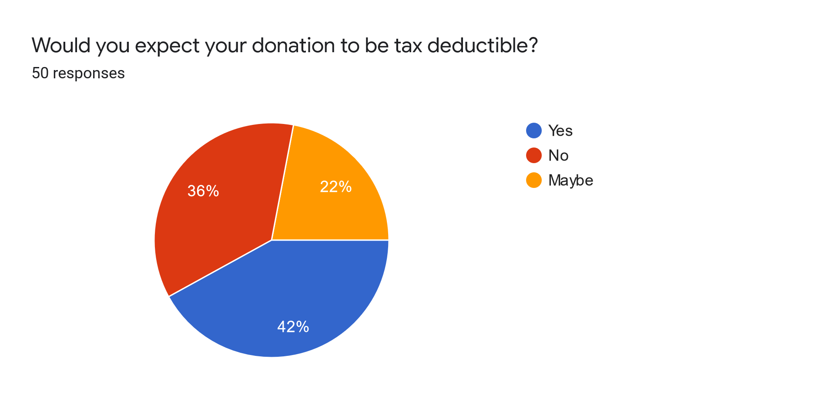
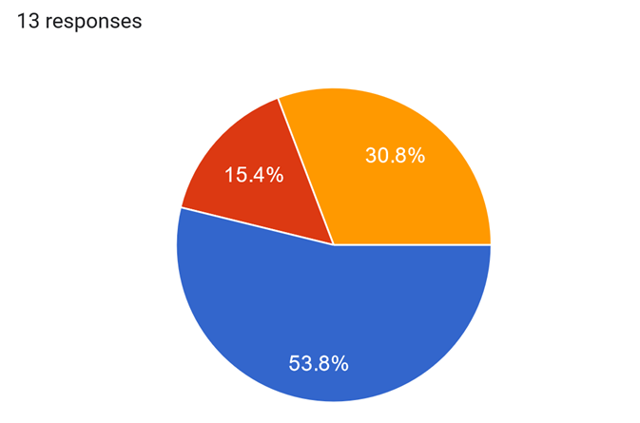
Tax deductibility

Slide 12
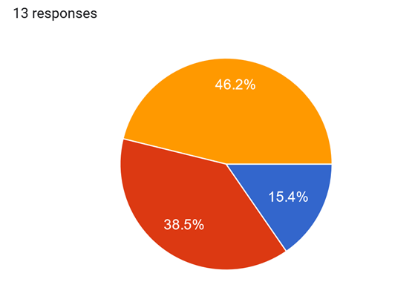
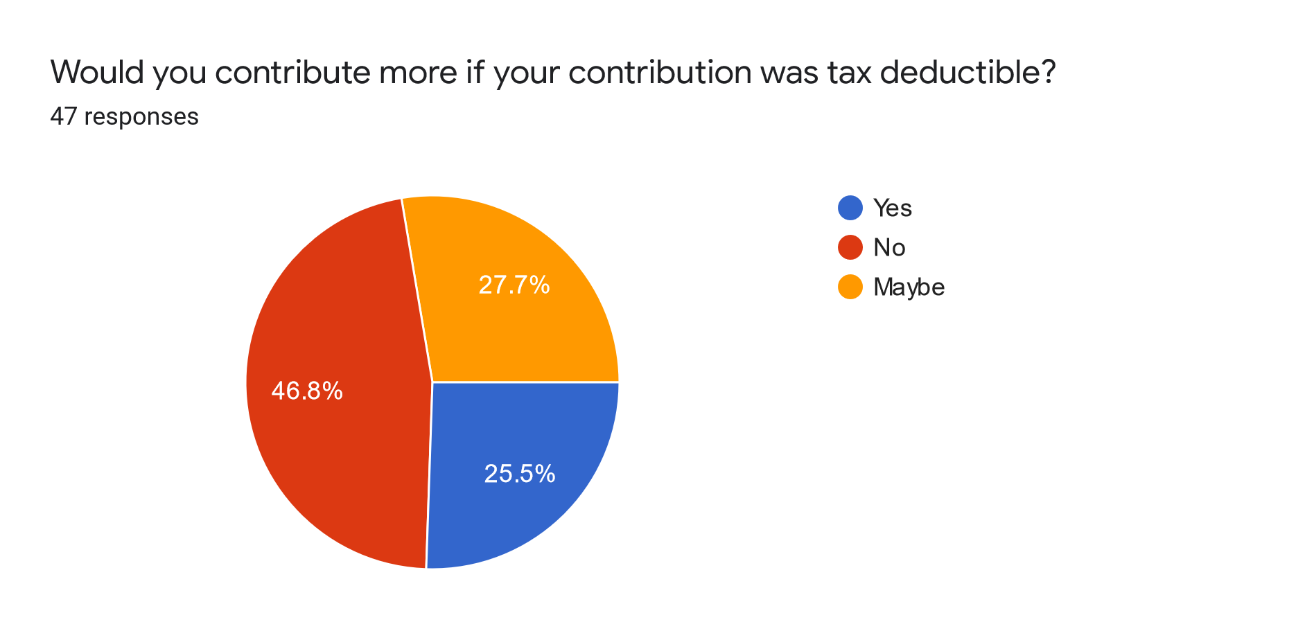
Tax deductibility more money?

Slide 13
Amount if Tax deductible
0 min
1000 max
41 average
15 median

Slide 14
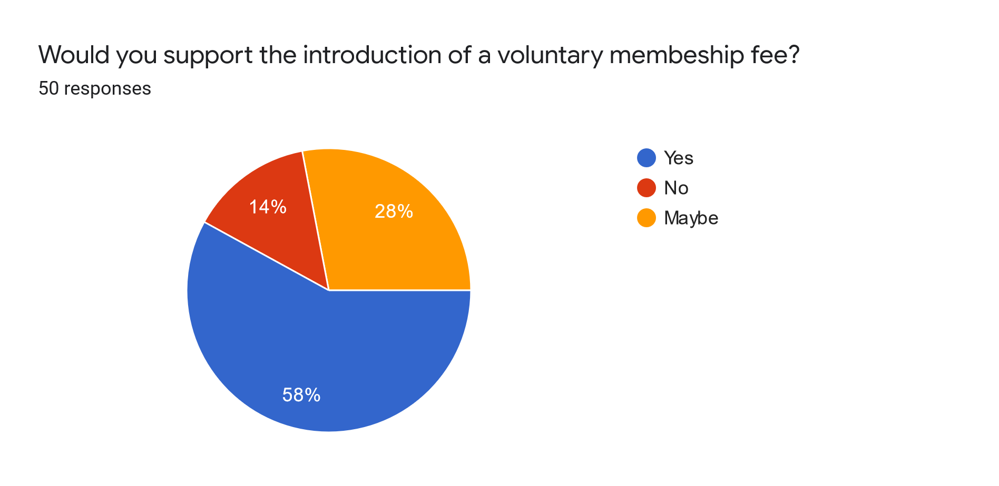
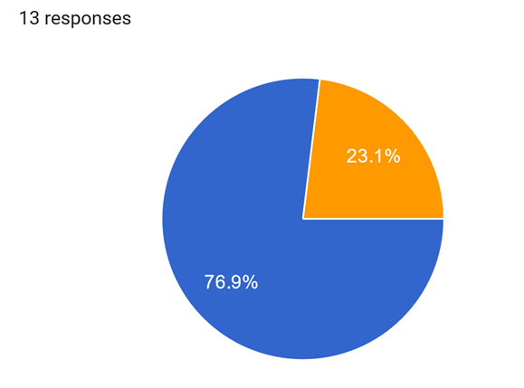
Voluntary membership fee

Slide 15
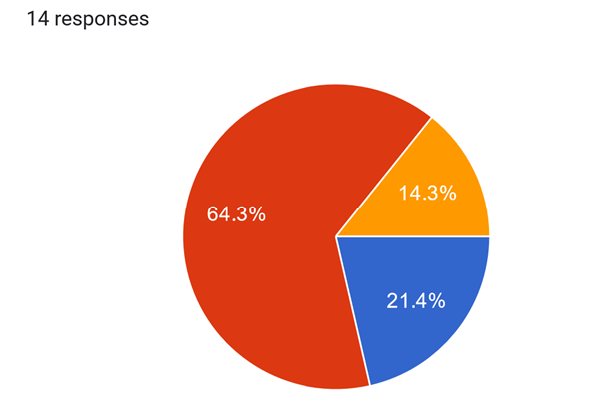
Required membership fee

Slide 16
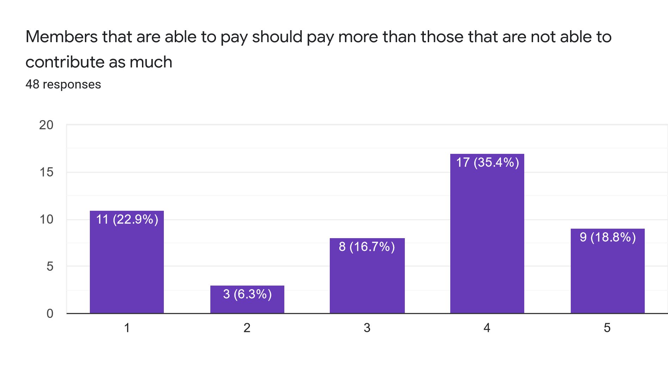
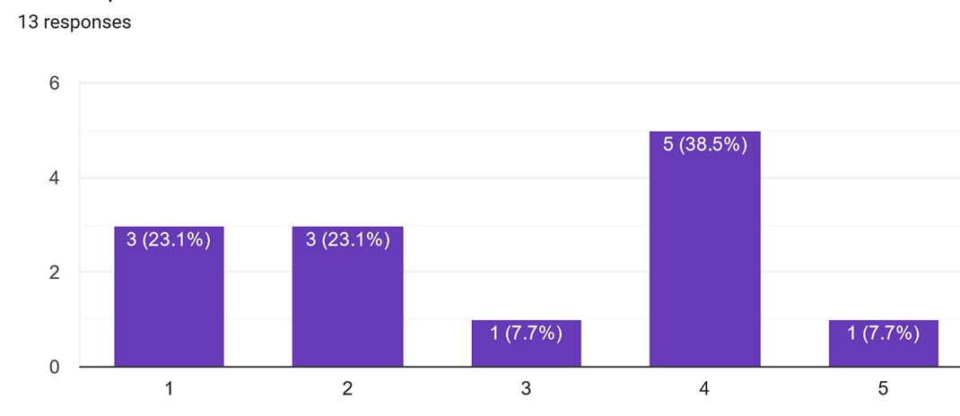
Earn more pay more?

Slide 17
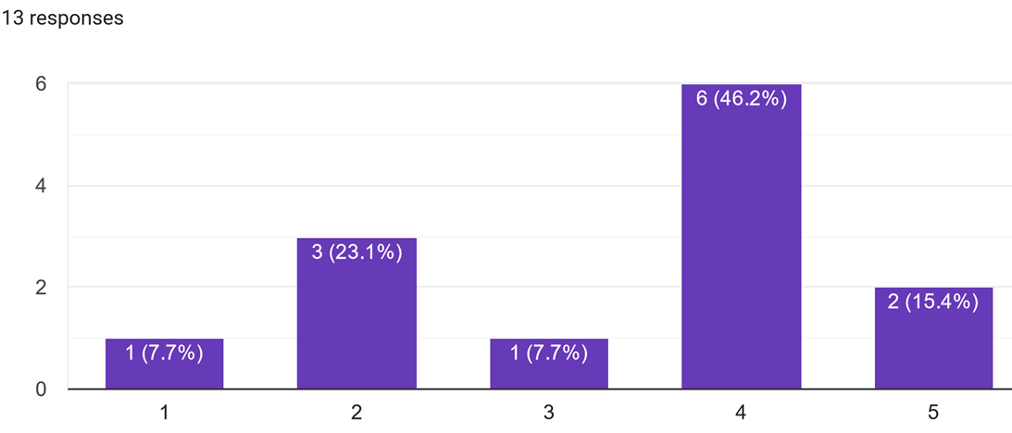
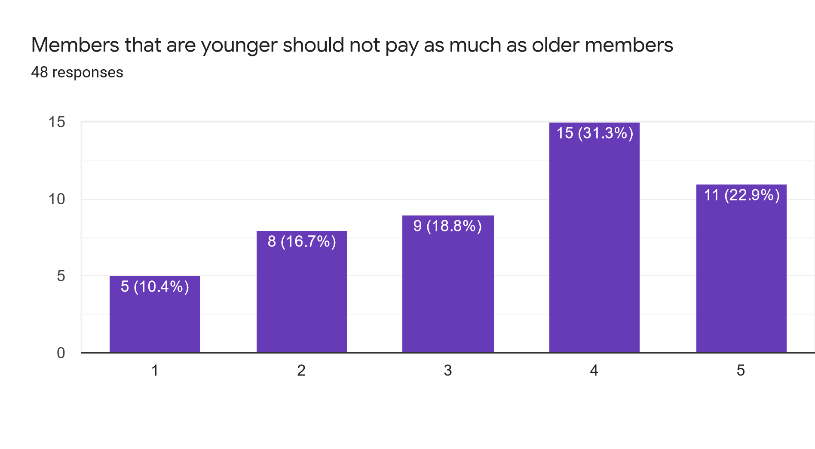
Younger pay less?

Slide 18
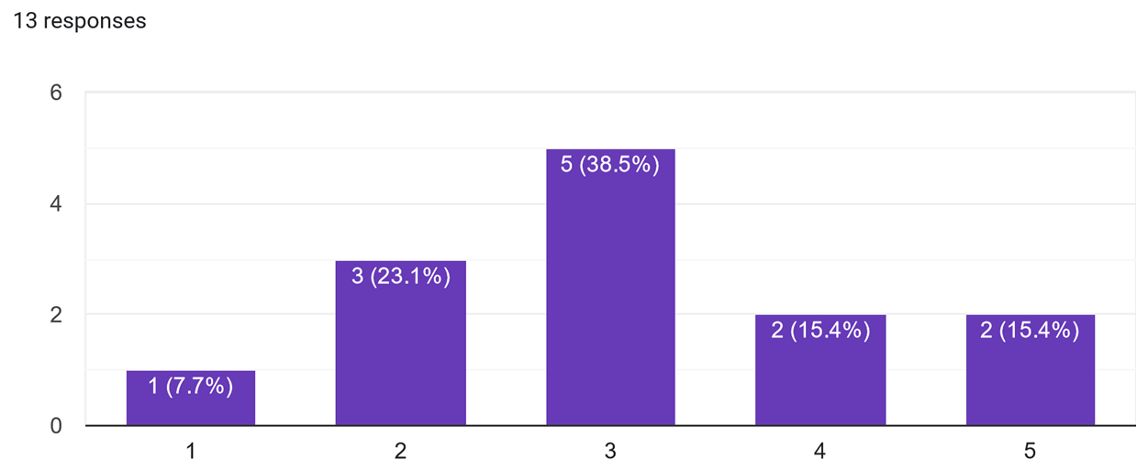
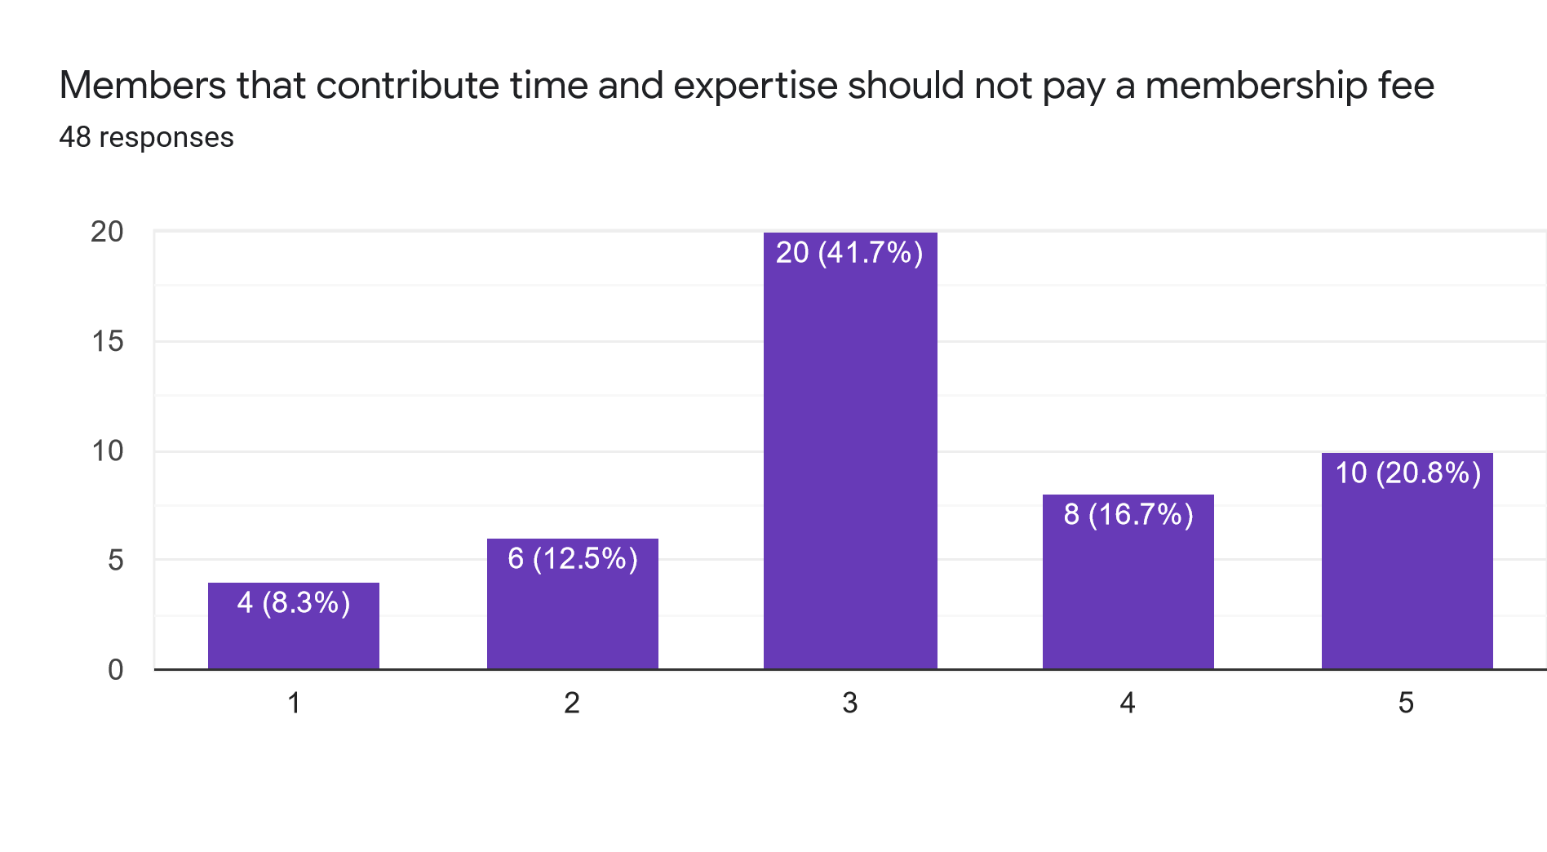
Experts pay less?

Slide 19
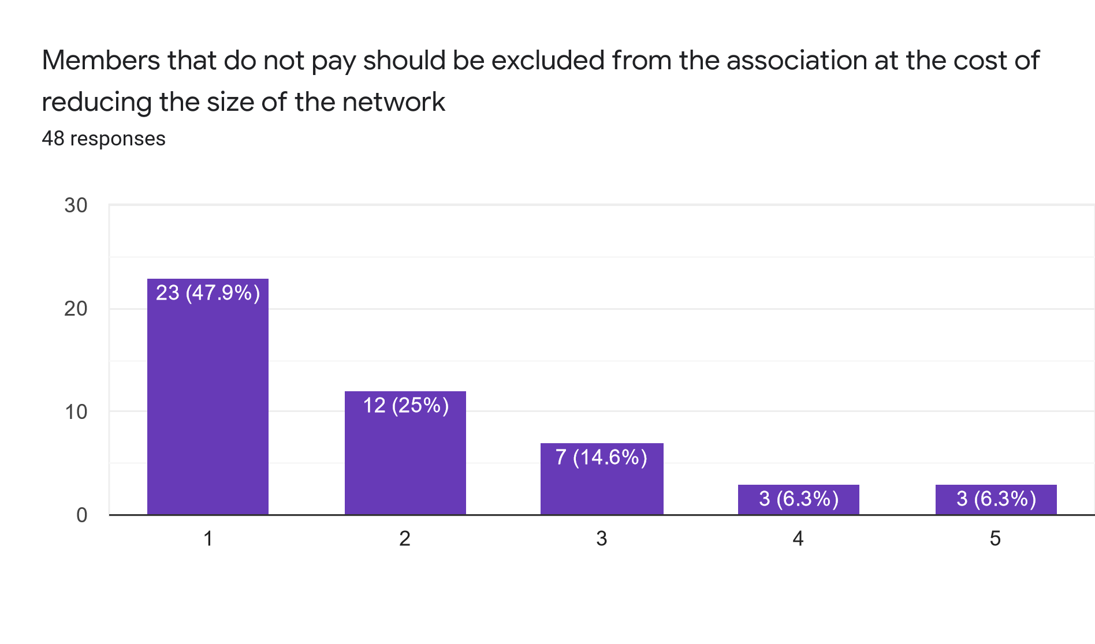
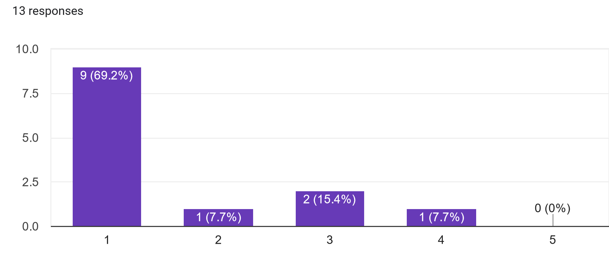
No pay = exclusion ?

Slide 20
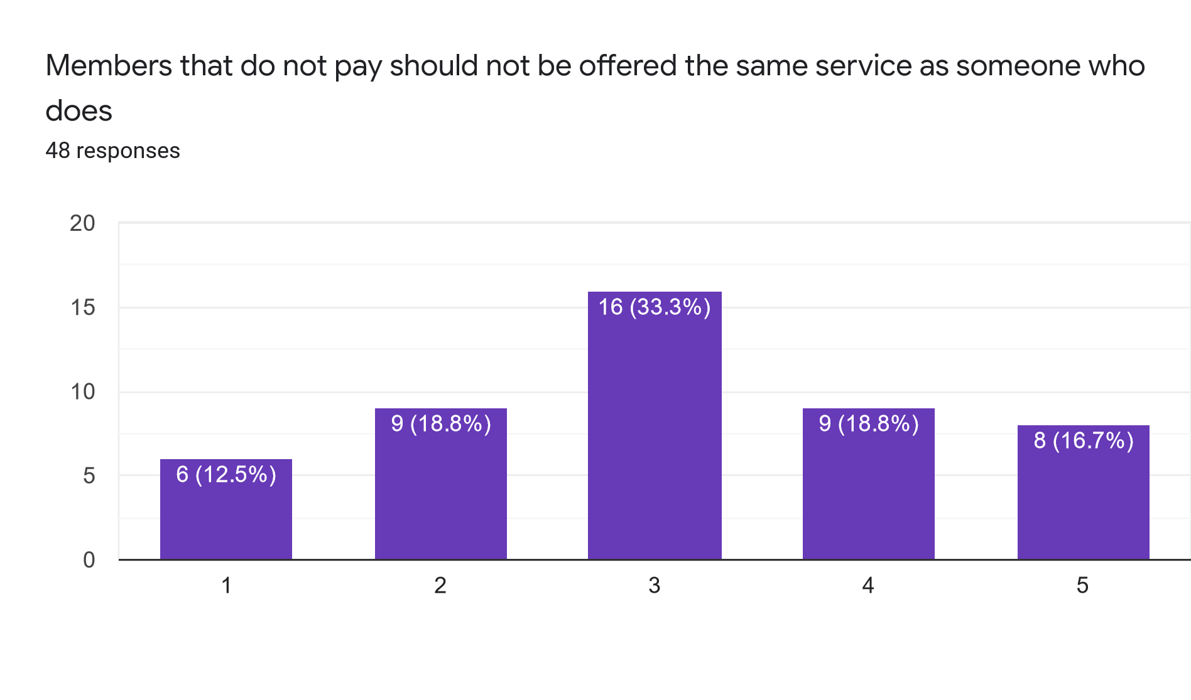
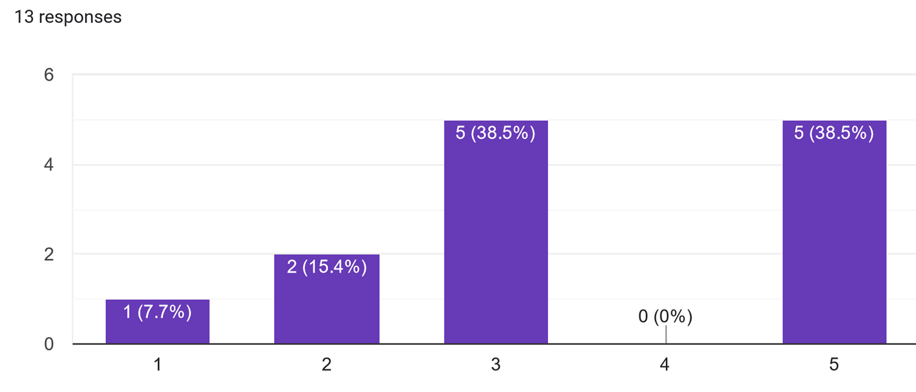
Pay = receive more?

Slide 21
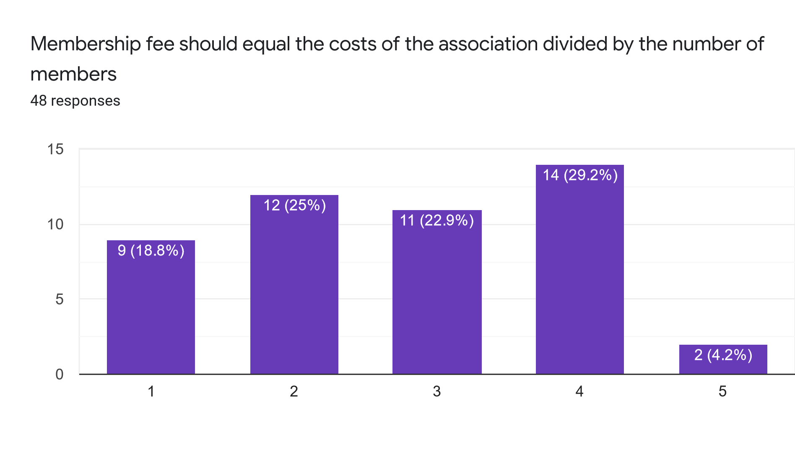
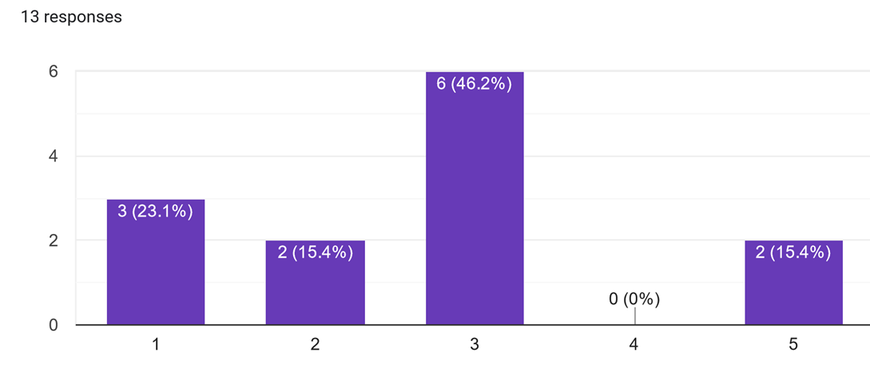
Cost vs Worth

Slide 22
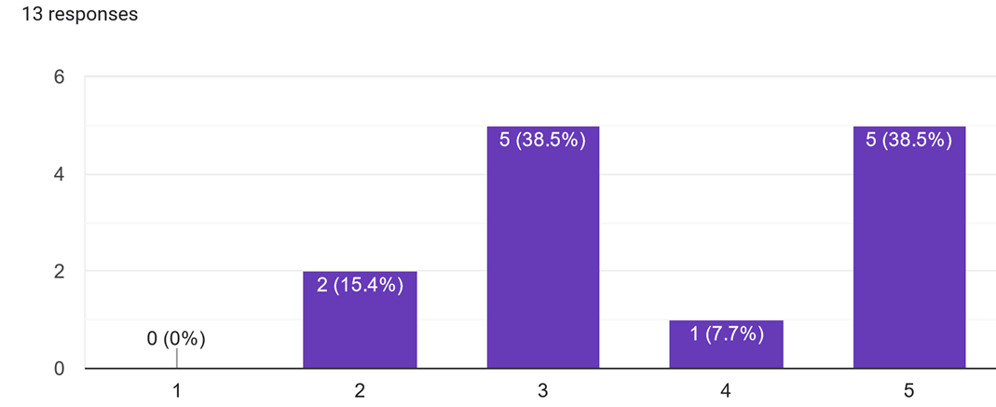
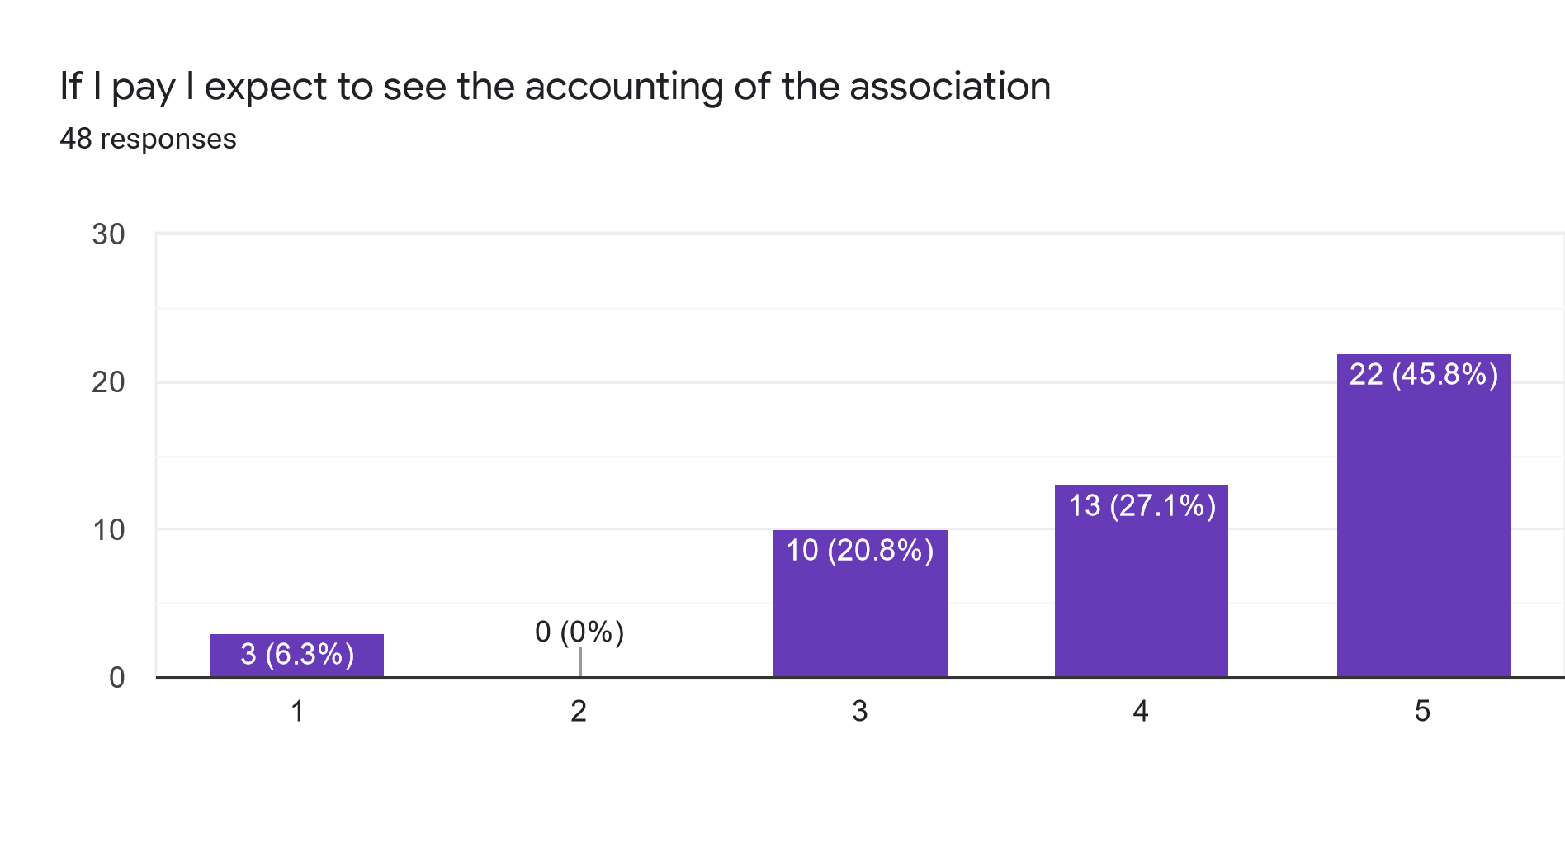
Accounting

Slide 23
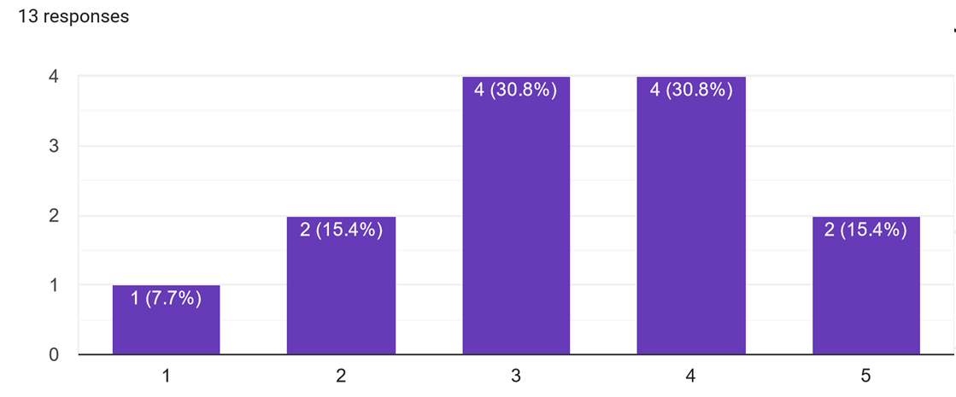
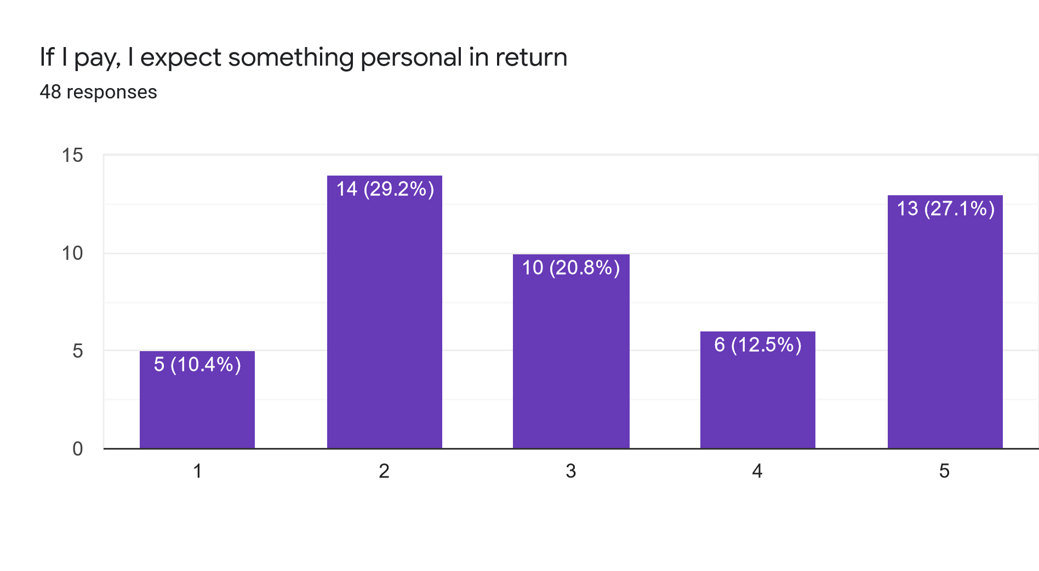
Personal gain

Slide 24
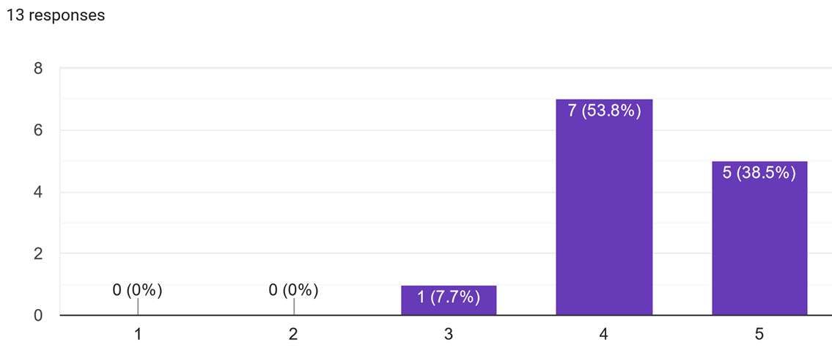
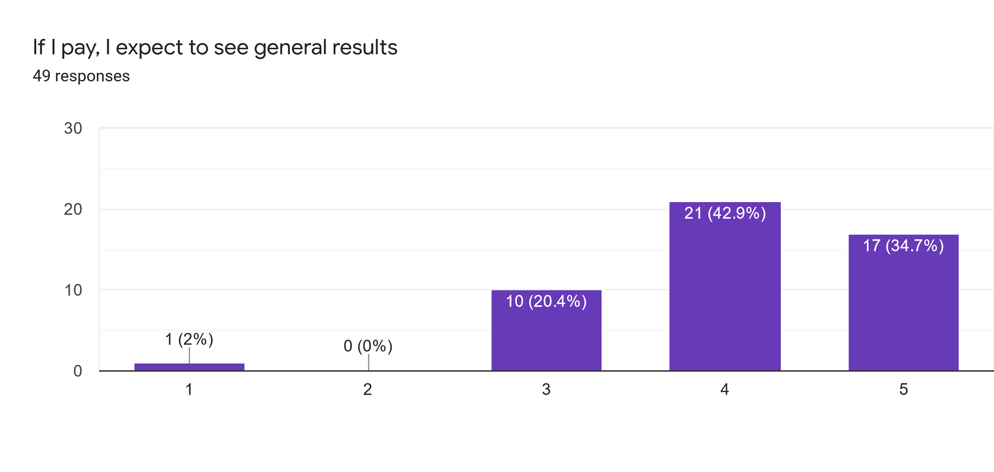
General results

Slide 25
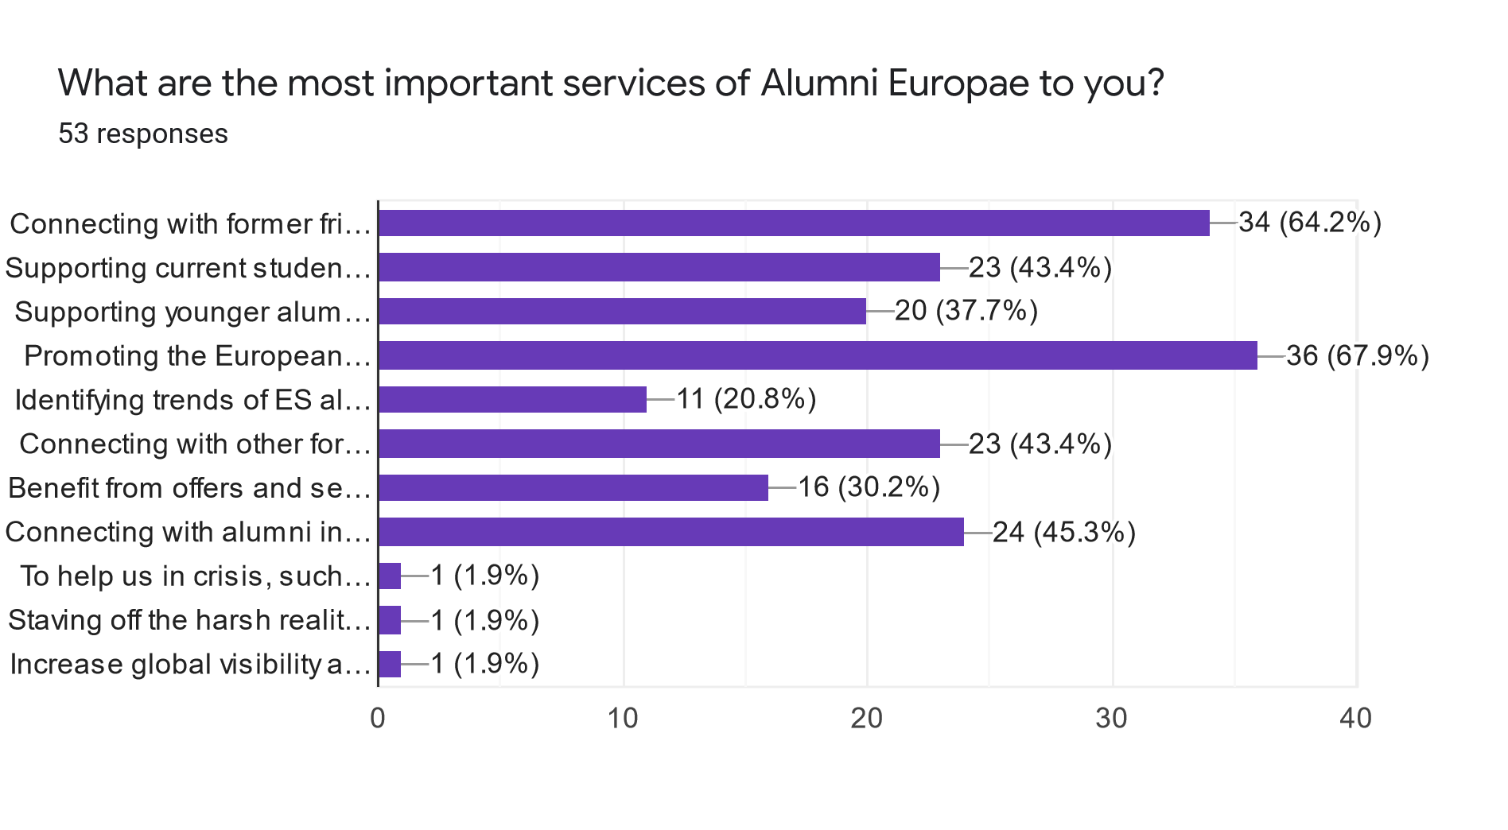
Important services

Slide 26
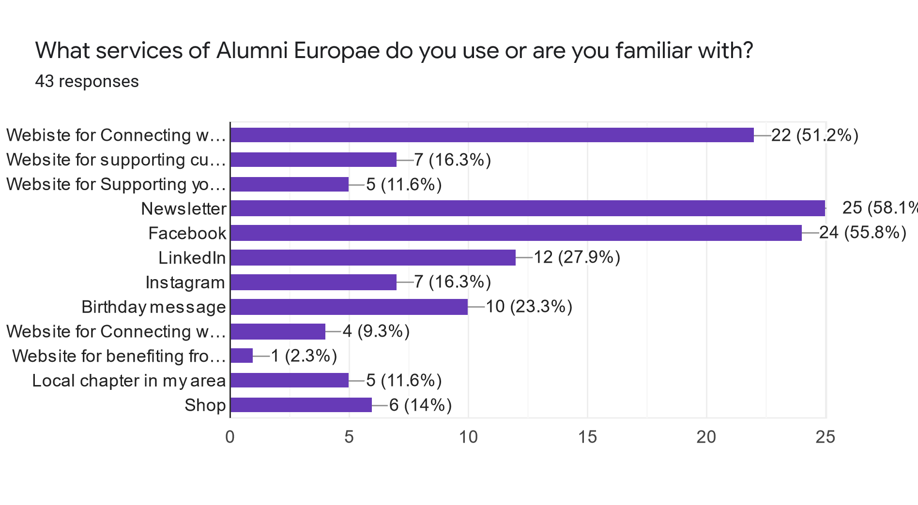
Familiar services

Slide 27
Conclusion
From the responses received, the board of Alumni Europae supports a voluntary yearly membership fee as structured below
0 euros for current ES students
1 euro for university students
15 euros for members
50 euros for members that can afford to

Slide 28
Conclusion
As per the answers received
The membership fee should be introduced via the website Pay function
Members who contribute to AE should not pay more than normal members
Members who do not pay should not be restricted in current functions
Extra functions should be available for paying members

Slide 29
Conclusion
The board of Alumni Europae will ensure
That the accounts of the association will be readily available for members
That the membership fee will show results for members notably in:
Promoting ES values
Connecting with former friends
Local chapters
Connecting with other ES alumni
Supporting younger alumni and current students

